Slide 1
Introduction

Slide 2
Objectives
The course presents algorithms and strategies for autonomous intelligent agents that move and interact with an unknown environment
In particular, the environment is represented by a virtual world created through video games technology
The aim of the course is to provide the basis for the design and development of software algorithms capable of autonomously acting within an environment
The student is introduced to different concepts of artificial intelligence (in particular, reinforcement learning) and supported through extensive exercises during lectures

Slide 3
Information
AulaWeb
https://2022.aulaweb.unige.it/mod/page/view.php?id=32708
Microsoft Teams Channel
https://bit.ly/aa2022-team (code: g4yq38y)
Slides (provided on Teams)
Jupyter Notebook (provided on Teams)
Lecture recordings (provided on Teams)
No streaming
Schedule
Monday 9:00-11:00 INFAL/1 (lecture)
Wednesday 11:00 – 13:00 DIME ITMAT (exercises)
Book (not strictly required)
M. Morales, Grokking Deep Reinforcement Learning, Manning

Slide 4
Grading
Oral examination on the theoretical topics covered during lectures
OR
Reading a scientific paper on a particular topic and prepare a presentation
20 minutes (strictly enforced!)
Presentation structure
problem addressed by the paper
motivation: application, gap in the literature, …
main ideas of the proposed algorithm or technique
OR
Design and develop an agent for a particular problem

Slide 5
Definition of Agent
Intelligent agents continuously perform three functions: perception of dynamic conditions in the environment; action to affect conditions in the environment; and reasoning to interpret perceptions, solve problems, draw inferences, and determine actions
[Barbara Hayes-Roth. 1995. Agents on stage: advancing the state of the art of AI. In Proceedings of the 14th international joint conference on Artificial intelligence - Volume 1 (IJCAI'95), San Francisco, CA, USA
An agent is anything that can be viewed as (a) perceiving its environment, and (b) acting upon that environment
[Stuart J. Russell and Peter Norvig. 1995. Artificial Intelligence: A Modern Approach. Prentice-Hall, Inc., Upper Saddle River, NJ, USA]

Slide 6
Agent

Slide 7
Why Games?
Limited, well-defined rules
Huge state spaces
highly complex
usually, no enough time to work out the perfect mode
Go, Chess
Test-beds for developing ideas and techniques useful also elsewhere
an ideal environment where hostile agents may compete
Nice, clean environment with clear criteria for success
Game playing is considered and intelligent human activity

Slide 8
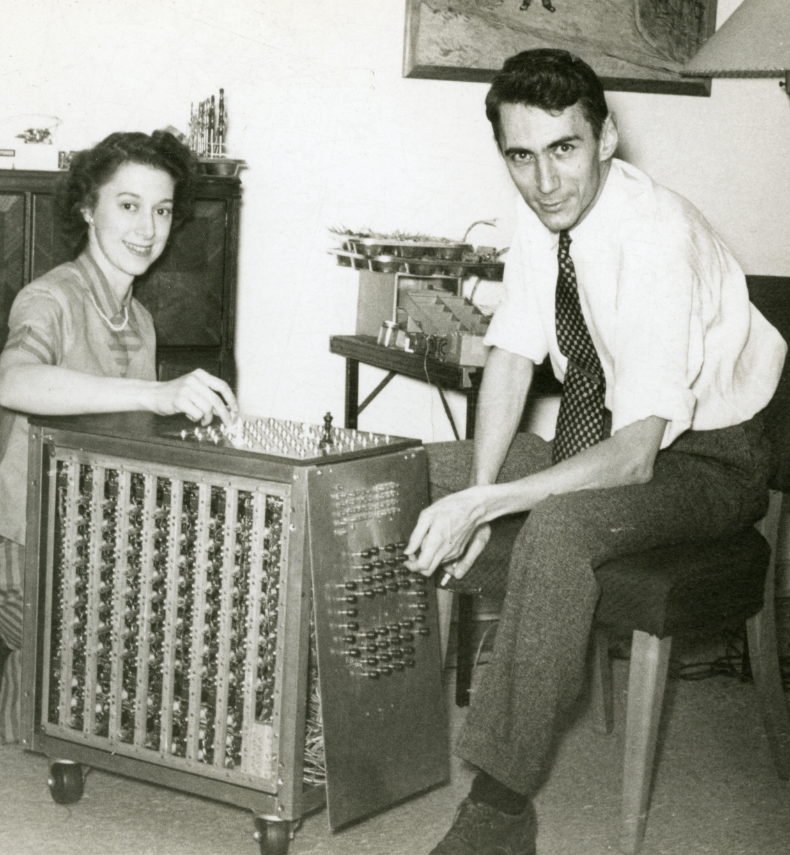
History of Game Agents (1)
Shannon demonstrating a machine he built to try programming rules for a limited version of Chess (1950)
Claude Elwood Shannon (1916–2001) was an American mathematician, electrical engineer, and cryptographer known as a "father of information theory"

Slide 9
History of Game Agents (2)
Arthur Samuel’s Checkers program developed for play on the IBM 701 (1956)
Arthur Lee Samuel (1901–1990) was an American pioneer in the field of computer gaming and artificial intelligence. He popularized the term "machine learning" in 1959.

Slide 10
History of Game Agents (3)
Kasparov vs IBM Deep Blue (1997)
Deep Blue was a chess-playing expert system run on a unique purpose-built IBM supercomputer. It was the first computer to win a game, and the first to win a match, against a reigning world champion under regular time controls.

Slide 11
History of Game Agents (4)
DeepMind's AlphaGo (Google) VS Fan Hui (2015)
AlphaGo is a computer program that plays the board game Go. It was developed by DeepMind Technologies, a subsidiary of Google. In October 2015, in a match against Fan Hui, AlphaGo became the first computer Go program to beat a human professional Go player on a full-sized 19×19 board.

Slide 12
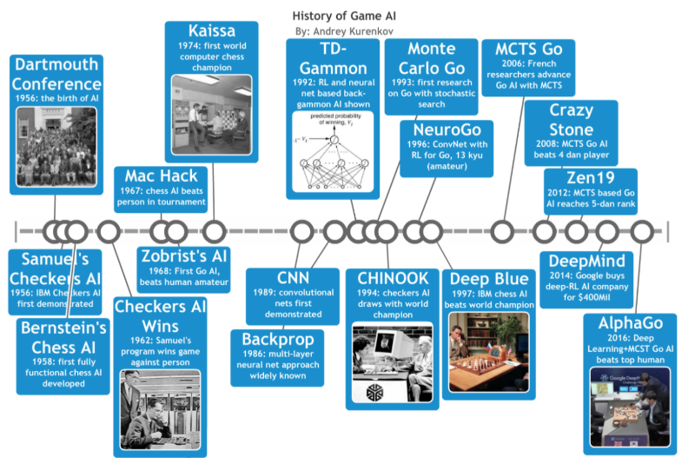
History of Game Agents (5)

Slide 13
Competitions
Mario AI
a benchmark for AI/CI/ML algorithms applied to Super Mario Bros
[Karakovskiy, S., & Togelius, J. (2012). The mario ai benchmark and competitions. IEEE Transactions on Computational Intelligence and AI in Games, 4(1), 55-67]
The General Video Game AI Competition
explores the problem of creating controllers for general video game playing
How would we can create a single agent that is able to play any game it is given?
[Perez-Liebana et al. General Video Game AI: a Multi-Track Framework for Evaluating Agents, Games and Content Generation Algorithms. IEEE Transactions on Games Volume: 11 Issue: 3]

Slide 14
Topics
Tree Search (Minimax and MCTS)
Markov Decision Process
Dynamic Programming
Exploration vs Exploitation
Policy Evaluation
Policy Improvements
Learning and Planning
Function Approximation
Deep Q-Learning
Policy-based methods
Actor-Critic methods

Slide 15
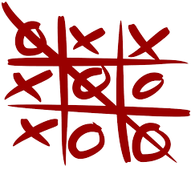
A toy example: TicTacToe (1)
Simple rules and low complexity (tree size)
3 x 3 = 255.168
(but 4 x 4 = 15.038.733.958.272)
A toy example:
mathematical solution
simple expert system
complete tree search (minimax)
experimenting learning techniques
Random players
random selection of actions
which is the win probability?
First player 737/1260 (about 58%)
Second player 363/1260 (about 28%)
Draw 160/1260 (about 13%)

Slide 16
A toy example: TicTacToe (2)
Rational VS Random player
rationality refers to the fact that agents would always prefer the higher reward/payoff considering what other agents will do
Probability is 1/192 (about 0.5%)

Slide 17
A toy example: TicTacToe (3)
Exercise: try to write a set of rules…
My solution:
if the board is empty, get a corner position
if you have a win position, get it
if the opponent has a win position, get it
if you have a “two pair” opportunity, get it
if the centre is free
if a lateral position is full, get the centre
if a non-opposite corner position is full, get the opposite corner
if the opposite corner position is full, get a adjacent corner
if you have a pair possibility, get it
get a free position
Simulation:
99.5% of win, 0.5% of draws (ok)
all the rules are necessary (?)

